Slide 1
Finding out if you chose the right school
Universities and their
Return on Investment
Fouad Yared

Slide 2
Treasure trove of data
US Dept of Education has locations of all universities, ranking of research institution, median income and debt of student body, and much more
7,000 universities/colleges with 1,700 variables
Treasury has earnings data 6-10 years from matriculation, by percentile
Census has metropolitan/micropolitan shapefiles, high school economic data
Looked at the 2014-15 academic year

Slide 3
Calculating ROI
How was return on investment calculated?
a) Multiplied median university earnings by 20
b) Multiplied in-state, out-of-state, public, and private tuition by 4
c) Multiplied US average high school earnings by 24
d) Then subtracted (a - b - c) to get four indicators of ROI

Slide 4
Do you get what you pay for?
Is ROI linked to a university's tuition?
Does graduating from a top school lead to a top wage?
What's the best school near me?

Slide 5
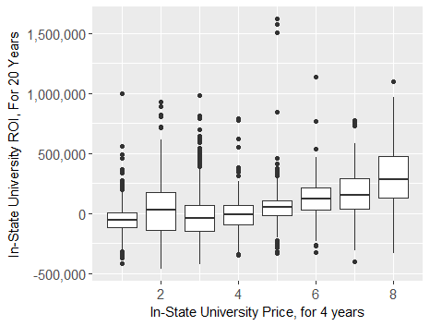
In-State Tuition by In-State ROI
Split by $25,000
intervals

Slide 6
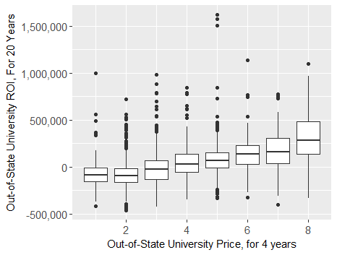
Out-of-State Tuition by Out-of-State ROI
Split by $25,000
intervals

Slide 7
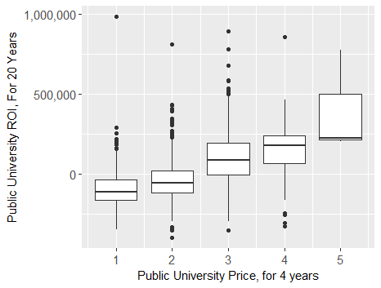
Public University Tuition by Public ROI
Split by $25,000
intervals

Slide 8
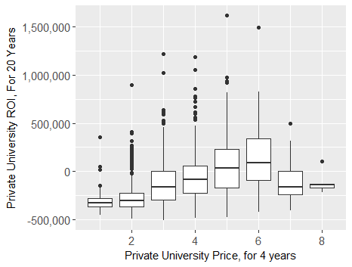
Private University Tuition by Private ROI
Split by $25,000
intervals

Slide 9
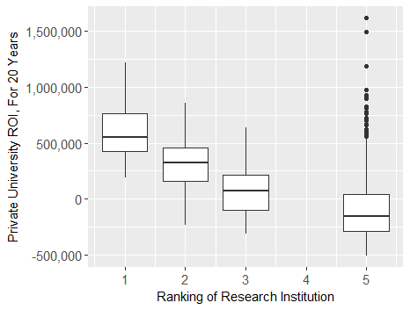
Ranking of Research Institution by Private ROI
1- Highest Rank
2 - Second Highest
3 - Third Highest
5 - Everything else

Slide 10
Limitations
Limitations / Further studies
Benefits outside of starting salary not evaluated
Name recognition of top college, networking with some of the top minds
How do salaries, unemployment rates vary by major? What are the unemployment rates by university?
How does cost of living affect one's ROI?
How does enrollment affect ROI?
Why are most colleges/univerities selected (proximity, cost, rigor, prestige, other)?
If students were informed a more expensive university would net a better ROI, would they go to the more expensive university? (assuming all other things are equal)

